Slide 1
Advance Electronic I
THIRD YEAR
Lecturer: Abbas S.
Hameed
Main References:
1- Robert L. Boylestad and Louis Nashelsky, “ Circuit Theory “.
Electronic
Devices and
2- Thomas L. Floyd, “ Electronic
Devices. CCV “.
3- Adel S. Sedra and Kenneth Carless Smith, “ Microelectronic circuits “.

Slide 2


Frequency Response
Electronic Devices and Circuit Theory 11th Ed., Robert L. Boylestad
For BJT and JFET
Lect 4 low freq. region
1- Electronic Devices and Circuit Theory by Robert L. Boylestad
2- Electronic Devices. CCV by Thomas L. Floyd
3- Microelectronic Circuits by Sedra/Smith

Slide 3
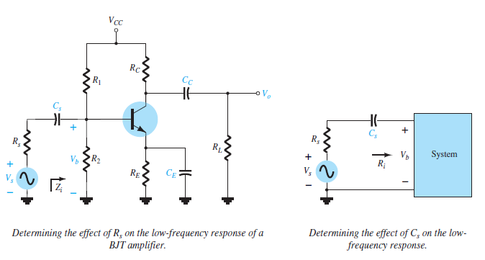

low-frequency region of the BJT

Slide 4
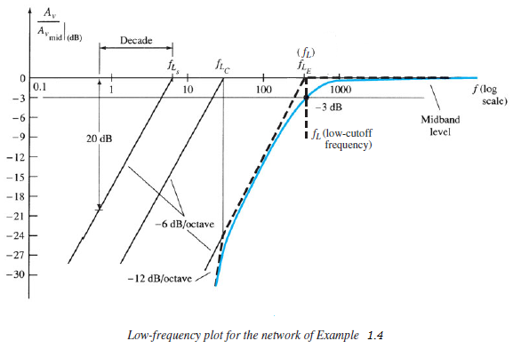

Slide 5
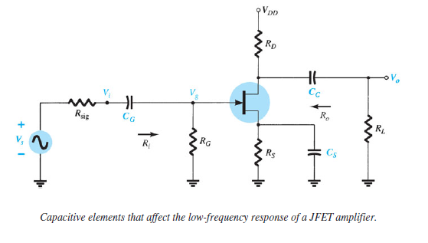

low-frequency region of the JFET

Slide 6
